Slide 1


Deception Detection using Facial Action Units
Candidato: Orfanelli Emanuele
Relatore: Luigi Cinque
Correlatore: Danilo Avola

Slide 2
Outline
Aim of the thesis
Use cases
System Architecture
Experiments and Results
Future work
Notes:
Durante questa presentazione vi parlero’ dell’obiettivo
Inizialmente vi esporro’..

Slide 3

Aim of the thesis
Goal: understand if it’s possible correctly to classify videos containing truthful or deceptive statements.
In particular by performing the analysis of facial muscle movements during the video.
Notes:
L’obiettivo di questa tesi e’ capire se e’ possibile classificare correttamente video in cui appaiono soggetti che dicono bugie o verita’, in particolare analizzandone i movimenti dei muscoli facciali durante il video.

Slide 4

Use cases
Security checks (airport, train stations…);
Interviews for sensitive positions;
Police interrogation;
Speech analysis (political).
Notes:
Una tale tecnologia potrebbe essere utilizzata per:
controlli di sicurezza
Usato dalla polizia come aiuto per gli interrogatori a criminali o sospettati
Analisi dei discorsi di candidati a ruoli politici

Slide 5
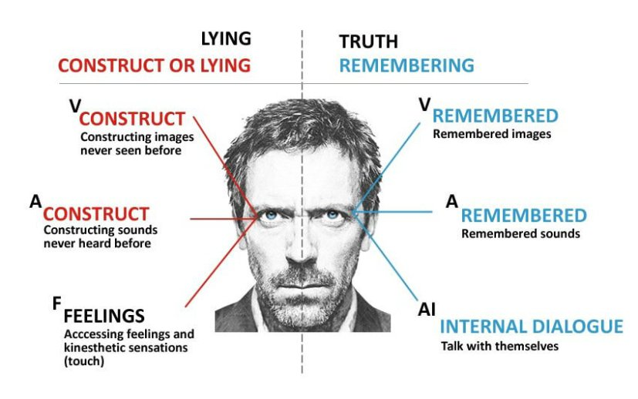
Different ways to detect lies
Psychological
Body language, micro-expressions, eye position;
Speech analysis
Speed, patterns, choice of words;
Neuroscience
EEG, fMRI;
Polygraph
Notes:
- Talk about contact and non contact, invasiveness.
La letteratura fornisce diversi metodi per capire se un soggetto mente o dice la verita’, alcuni invasivi, cioe’ in cui il soggetto deve essere a conoscenza e collaborare
Psicologici:
Analisi del discorso
Neuroscientifici
Immagini termiche

Slide 6
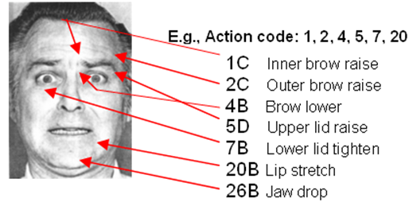
Action Units
Action Units (AU) correspond to contraction or relaxation of one or more muscles.
AUs can be used to codify emotions and expressions through the muscles involved and the intensity of the movements.
Notes:
L’indicatore che abbiamo scelto di utilizzare per capire se una persona mente…
Le AU possono essere utilizzate per codificare le emozioni attraverso lo studio dei movimenti muscolari dei soggetti e delle loro intensita’.
Breve accenno a FACS

Slide 7
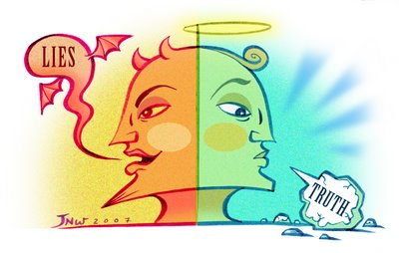
Idea
Decompose truthful and deceptive statements into Action Units.
Truthful and deceptive statements should present different Action Units combinations and frequency.
Notes:
Prendere dei video in cui I soggetti mentono o dicono la verita’ ed estrarre le AU analizzando le facce dei soggetti, assumendo che un soggetto che mente utilizzi delle combinazioni e delle frequenze di AU differenti da uno che dice la verita’

Slide 8
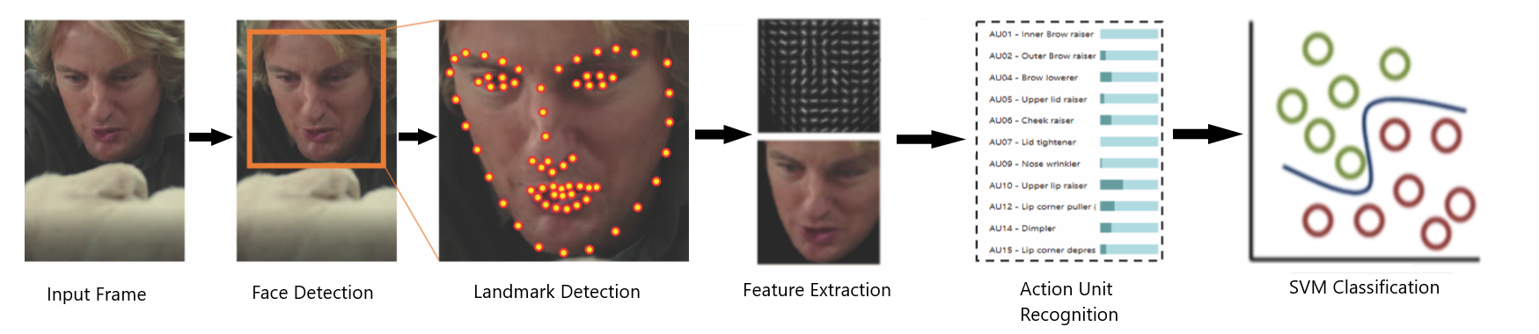
Architecture
Input Video / Frame;
Face Detection;
Landmark Detection;
Feature Extraction;
AU Recognition;
SVM Classification;
Notes:
Ad alto livello il nostro Sistema funziona nel seguente modo:

Slide 9
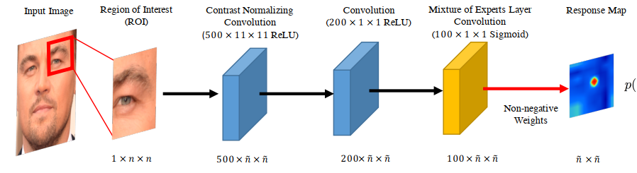
Facial Landmark Detection
Model based approach models both appearance and shape of facial landmarks explicitly with the latter constraining the search space and providing a form of regularization
Two Phases:
Response map computation using Convolutional Experts Network
Shape parameter update
Notes:
Is this too much? Should I skip it since I don’t know too much about this? Should I say I use OF for this? “we use a library…”
https://ibug.doc.ic.ac.uk/media/uploads/documents/tpami_alignment.pdf – spiega un po’ resp map
Riorganizzare slides per spiegare CE CLM cos’e’ un minimo?

Slide 10
Facial Landmark Detection
Convolutional Experts Constrained Local Model (CE-CLM)
Convolutional Experts Network as local detector
Computes a response map to accurately localize individual landmarks by evaluating the landmark alignment probability at individual pixel locations.
Individual landmark alignment is estimated independently of the position of other landmarks.
Notes:
NEW SLIDE MAYBE LIKE THIS

Slide 11
Facial Landmark Detection
Convolutional Experts Constrained Local Model (CE-CLM)
Convolutional Experts Network as local detector
Computes a response map to accurately localize individual landmarks by evaluating the landmark alignment probability at individual pixel locations.
Individual landmark alignment is estimated independently of the position of other landmarks.
Constrained Local Model for shape parameter update
During the parameter update, the positions of all landmarks are updated jointly and penalized for misaligned landmarks and irregular shapes using a point distribution model
Control the landmark locations and to regularize the shape
Notes:
Is this too much? Should I skip it since I don’t know too much about this? Maybe just reduce it.

Slide 12
Feature Extraction
Alignment and Masking
Need for a mapping to a common reference frame to better analyze the image.
﻿Similarity transform from the currently detected landmarks to a representation of frontal landmarks from a neutral expression (a projection of mean shape from a 3D PDM)
Procrustes superimposition that minimized the mean square error between aligned pixels
﻿Masking is performed using a convex hull surrounding the feature points
Results in a 112x112 pixel image of the face
Notes:
Una volta estratti I landmark, per procedere alla fase di estrazione delle feature, ci e’ utile allineare l’immagine ad una frame di reference frontale…
REVIEW THIS SLIDE

Slide 13
Feature Extraction
Appearance Features:
12x12 block of 31 dimensional Histogram of Oriented Gradients are extracted.
4464 dimensional vector for the face.
PCA to get a vector of 1379 features.
Geometry Features:
Vector of dimension 227 from landmark locations and shape parameters from the PDM
Total of ﻿1606 features that define the face.
Notes:
Una volta allineata l’immagine procediamo all’estrazione delle feature.
Ci sono due tipi di features che estraiamo: appearance features e geometry features.
Le appeareance features vengono estratte sotto forma di HoG, e utilizzando la PCA arriviamo ad avere un vettore di 1379 features
Le geometry features invece dipendono dalla posizione dei landmark e dai parametri del PDM usato nella seconda fase della landmark detection
Arriviamo cosi’ ad un totale di 1606 features che descrivono la faccia.

Slide 14
Action Unit Detection
Detect occurrence and intensity of Action Units
For AU occurrence detection Support Vector Machines.
For AU intensity estimation Support Vector Regression.
Linear Kernel in both cases.
Notes:
Una volta che abbiamo questo vettore il passo successive e’ quello di identificare le AU e la loro intensita’.
Per identificare le occorrenze delle AU utilizziamo un SVM, mentre per stimarne l’intensita’ un SVR. In ambedue I casi utilizzano linear kernel.

Slide 15
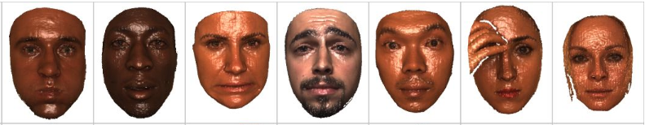
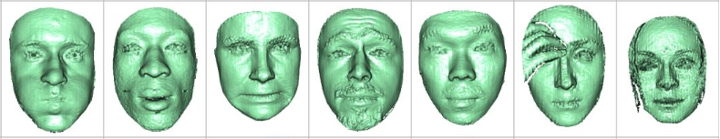
Action Unit Detection
Trained on four dataset: ﻿DISFA, BP4D-Spontaneous, SEMAINE and Bosphorus .
Datasets consist of videos of people subject to emotion inducing tasks, with AUs annotated.
Notes:
- Binghamton-Pittsburgh 3D Dynamic Spontaneous Facial Expression Database
- Denver Intensity of Spontaneous Facial Action Database
-
Probably too detailed with the Aus in common?

Slide 16
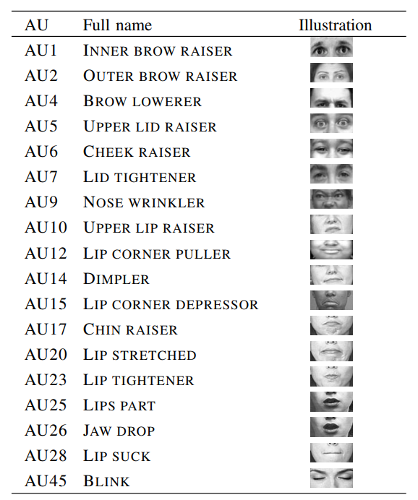
Action Unit Detection
Can recognize the following 18 AUs:

Slide 17
Training Dataset
Real life trial videos. High stakes.
121 videos.
61 deceptive, 60 truthful.
58 subjects.
Cut/Remove so that subject’s face is visible.
Label based on the outcome of the trial.
Testimony were verified by police officers.
Notes:
Il dataset che usiamo in input e’ composto da video di veri e propri processi. Questo e’ fondamentale in quanto in molti studi sul riconoscimento delle menzogne i video non sono spontanei ma viene chiesto ai soggetti di mentire spesso senza una forte motivazione.
Le label dei video sono basate sul risultato del processo e le testimonianze sono state verificate da agenti di polizia.
How many sbj in the train set? How many in the test set?
Dire che deriva da un paper?

Slide 18
Training Dataset
Data stats:
~86.000 total frames
~72.000 frames for train set
~14.000 frame test set
Person specific division due to overfitting, often the same identity is either uniformly deceptive or truthful.
A deception detection method may simply degenerate to person reidentification, if videos of the same person were included in both the training and test
40 train, 18 test
Notes:
Per evitare overfitting e training specific su persone….
Dico che abbiamo visto che la divisione in test e train normale overfittava?

Slide 19
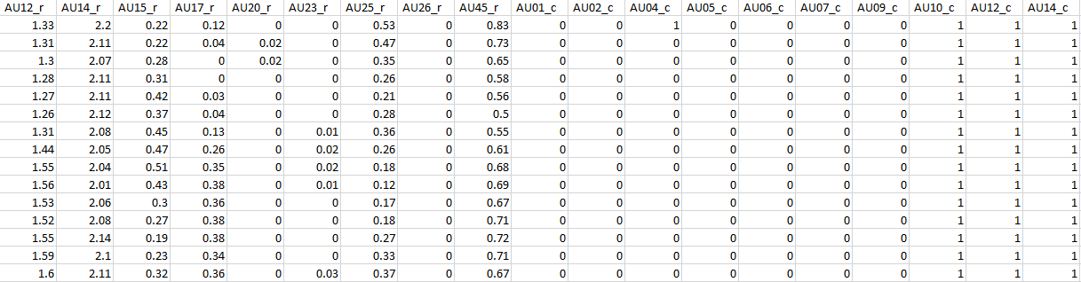
Deception Detection
Structure of the data:
Removal of all 0s rows
Presence Boolean 0 or 1
Intensity from 0 to 5
Three sets of data for analysis
Only presence
Only intensity
Presence & Intensity

Slide 20
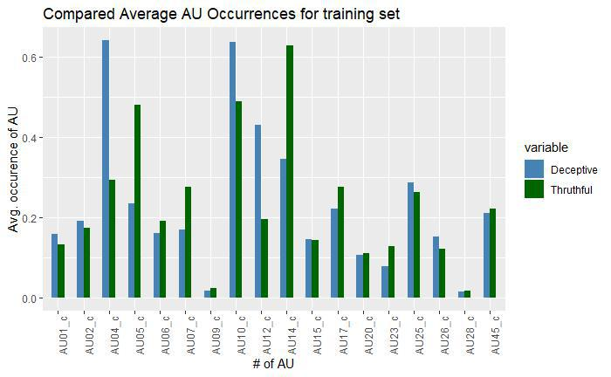
Deception Detection
Frequency analysis of AU occurrences in the train set.
Significant differences for truthful and deceptive in:
AU04
AU05
AU07
AU12
AU14
Notes:
Nomi delle AU?
Altra con diff test?

Slide 21
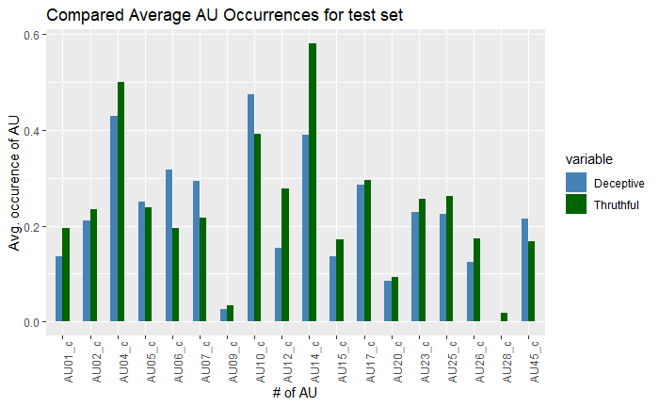
Deception Detection
Frequency analysis of AU occurrences in the test set.
Significant differences for truthful and deceptive in:
AU
AU
AU
AU
AU
Notes:
PUT Aus
Keep it or just train?

Slide 22
Deception Detection
Frequency analysis of AU occurrences in the test set.
Significant differences for truthful and deceptive in:
AU04
AU05
AU07
AU12
AU14
Notes:
Nomi delle AU?
Altra con diff test?

Slide 23
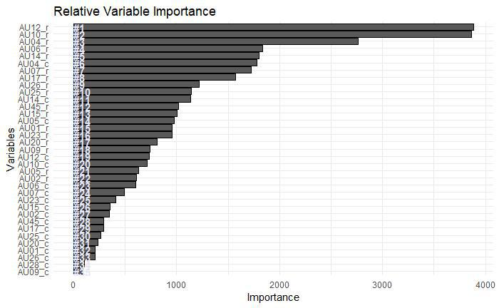
Deception Detection
Variable Importance using Random Forests
Notes:
Don’t have much to say about this
Dire 58%?
Elenco var tipo slide sopra?

Slide 24
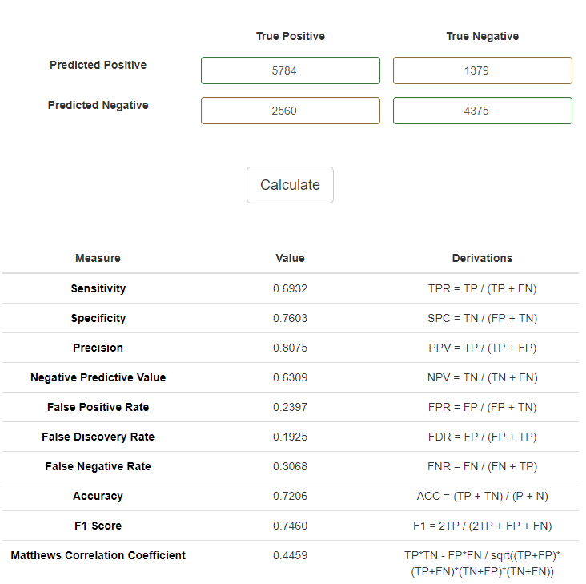
Deception Detection Results
Classification with Radial Basis SVM
72% accuracy on the test set
Notes:
Add confusion matrix?
Dire di altri kernel? Se si quanto?
Parametri SVM?

Slide 25
Future Work
Bigger dataset containing videos of better quality;
Temporal information for Action Units using LSTM;
Extend extraction to more than one person;
Analyze interactions;
Multimodal approach (thermal, body, words);
Implement heuristics based on psychological studies.

Slide 26
Thank you

Slide 27

Questions?

